Slide 1
Quarterly Convening
June 14, 2022

Slide 2
Agenda
9:00-9:20 | Opening, Awards, and Strategic Plan Update
9:20-10:00 | Community Engagement at Norwalk ACTS
10:00-10:05 | Break & Board Slate Vote
10:05-10:55 | Community Engagement Workshop
10:55-11:00 | Closing

Slide 3
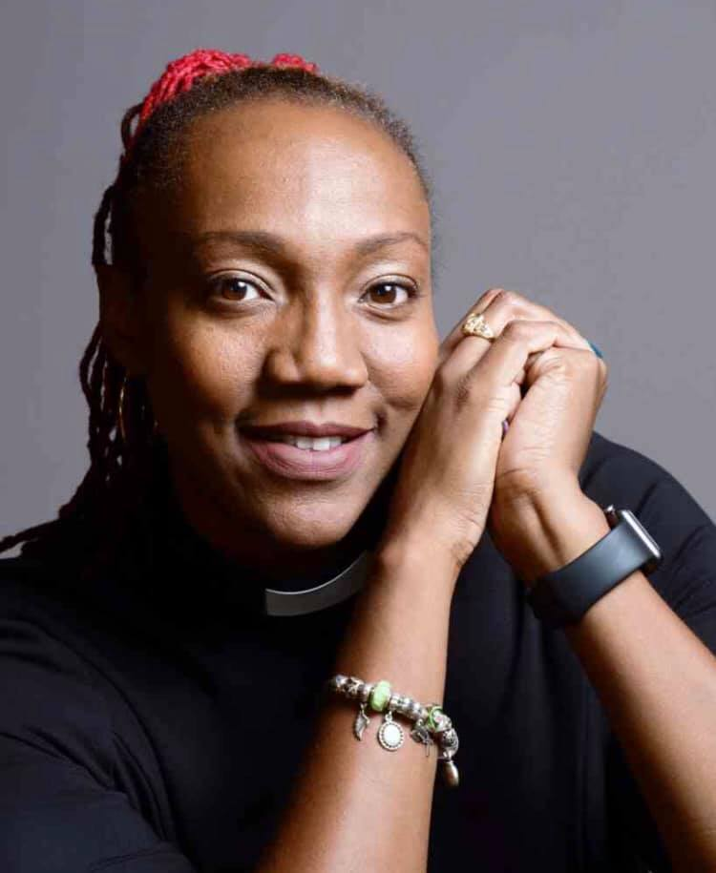
2022 Sally Grose Award
Presented by Rev. Lindsay Curtis to
Rev. Elizabeth Abel
Notes:
gement: process by which community members are included in and contribute to collective impact initiatives

Slide 4
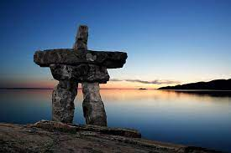
Ubuntu Award - I am, because you are
Ubuntu exists when people unite for a common good; that if we join together we can overcome our differences and our problems. Whoever we are, wherever we live, whatever our culture, Ubuntu can help us coexist in harmony and peace.
Notes:
Started in 2020 as a way to honor Anthony Allison. Anamilena Moreno, the first recipient will present the award

Slide 5
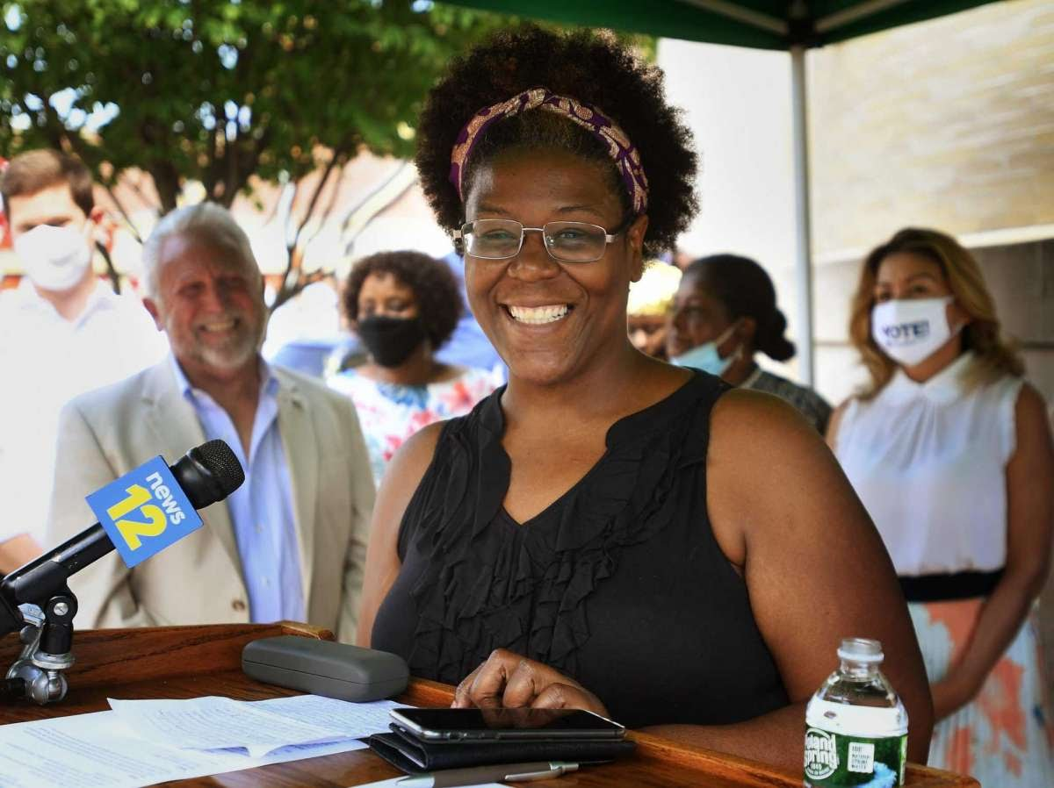
2022 Ubuntu Award
Presented by Anamilena Moreno to
Angel Dorleans
Notes:
gement: process by which community members are included in and contribute to collective impact initiatives

Slide 6
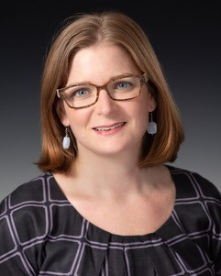
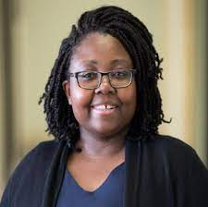
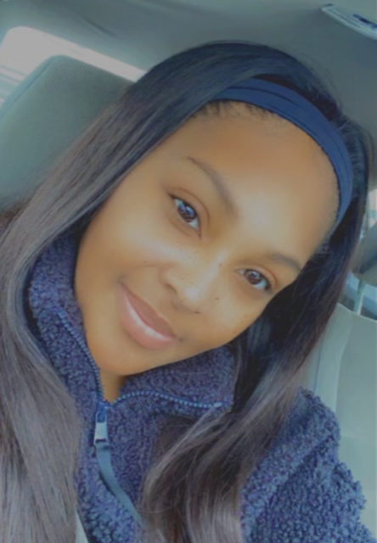
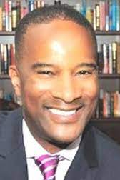
2022-23 Proposed Board of Director Slate
Julie Corbett
Adyna Gamboa
Diamond Sead
Ken Waller
*Only Norwalk ACTS members who signed the 2020 MOA are eligible to vote.
Thank you to Rich Wenning for his 3 year service on the Board!
Notes:
https://forms.gle/nAapqREjF6ctHGNk6

Slide 7
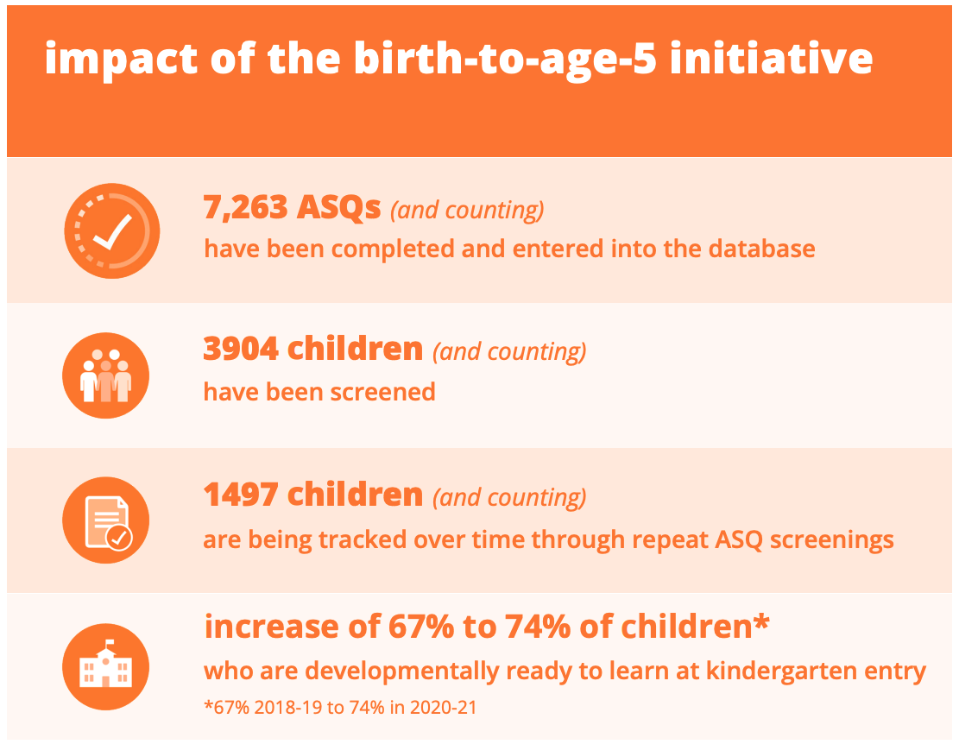
Celebrating Norwalk ACTS’ strengths over the decade
Connective Tissue for Organizations & Institutions
Instilling Data as a Cornerstone
Building a Collaborative Early Childhood system

Slide 8
To achieve our vision, our big bet over the next 3 years
Disciplined Initiative focus through the work of cornerstones and shifting ownership to community
Narrowing focus of Initiative goals and structure to improve outcomes
Building capacity and alignment through cornerstones with community at the core

Slide 9
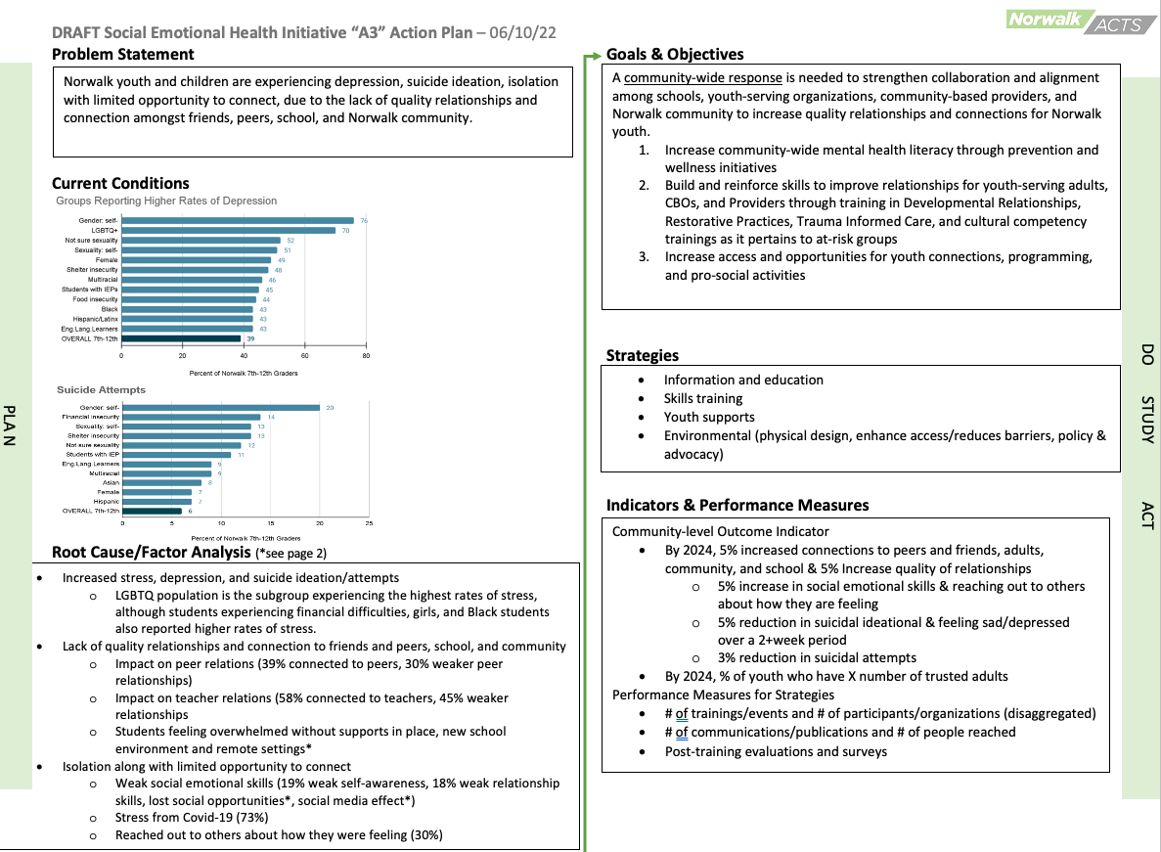
Narrowing focus of Initiative goals to improve outcomes
One page action plan summary as an anchor
Detailed annual action plan (separate) for Initiative leadership and membership

Slide 10
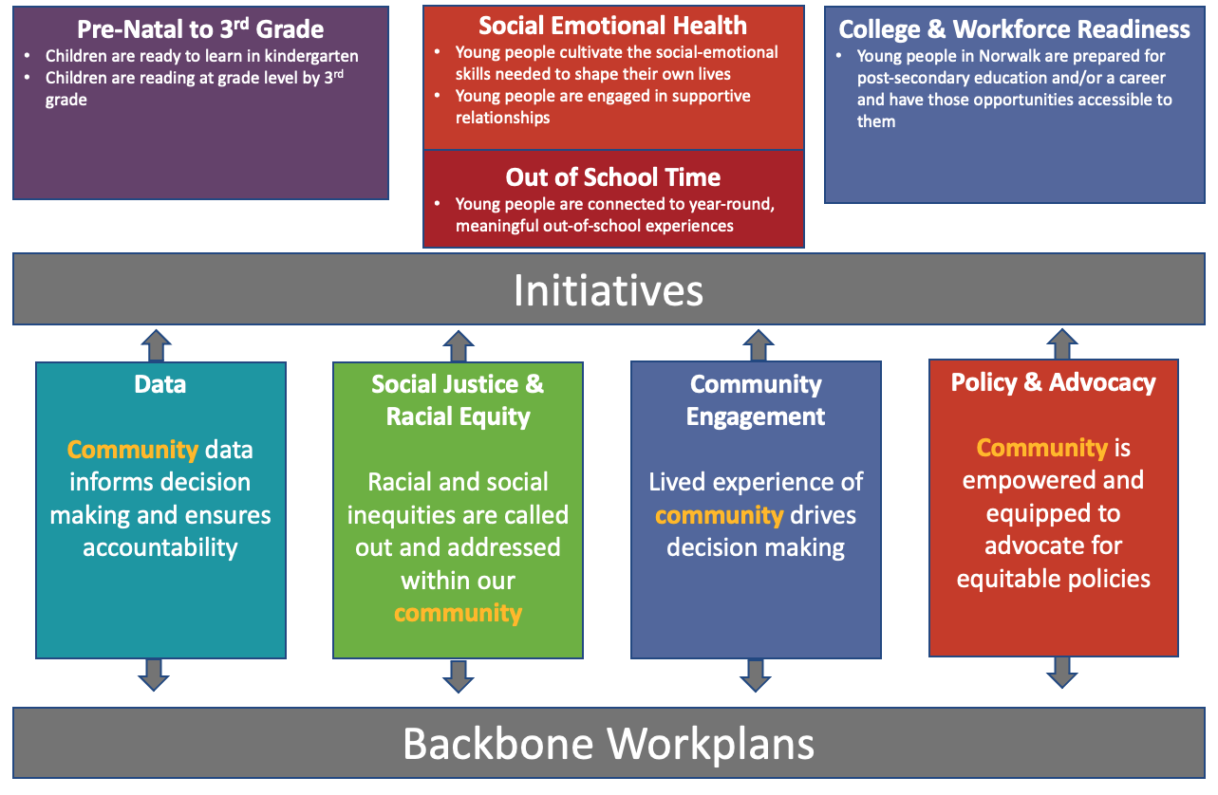
Building capacity and alignment through cornerstones with community at the core

Slide 11
What to look for
Over the summer
Initiative leadership & backbone action planning and feedback
By September Convening
Published strategic plan that includes our big bet, cornerstone priorities, and Initiative one-page action plans
Notes:
-Jesse

Slide 12
Community Engagement Definitions
COMMUNITY: The residents (children, young adults, adults and seniors) who live in Norwalk and the people and organizations who work to help make Norwalk a better place.
COMMUNITY ENGAGEMENT: The process by which community members are included and contribute to collective impact initiatives.
COMMUNITY ENGAGEMENT VALUE: Lived experience of community must drive decision making

Slide 13
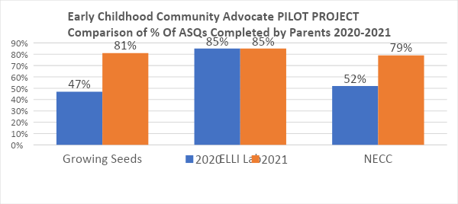
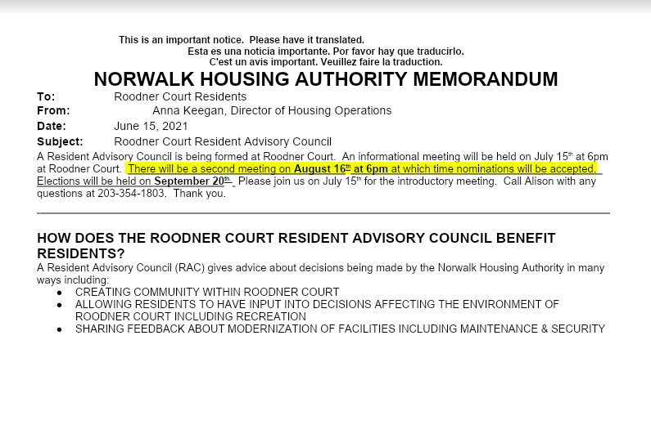
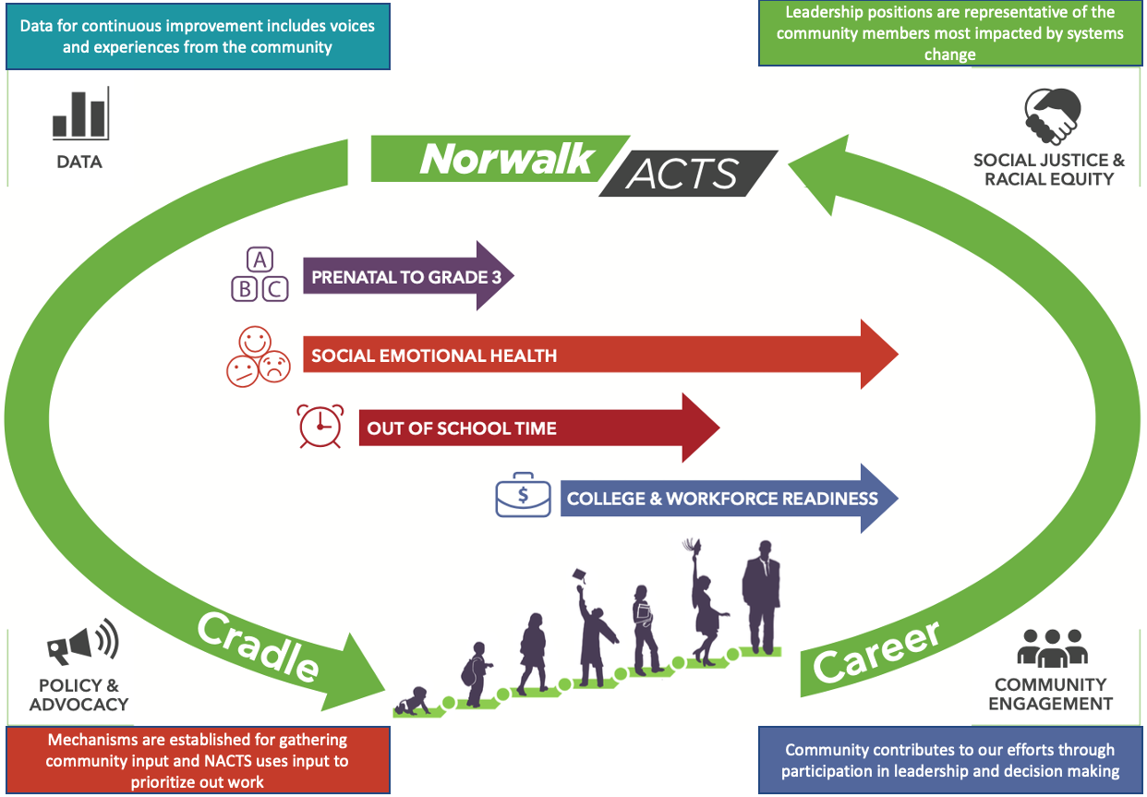
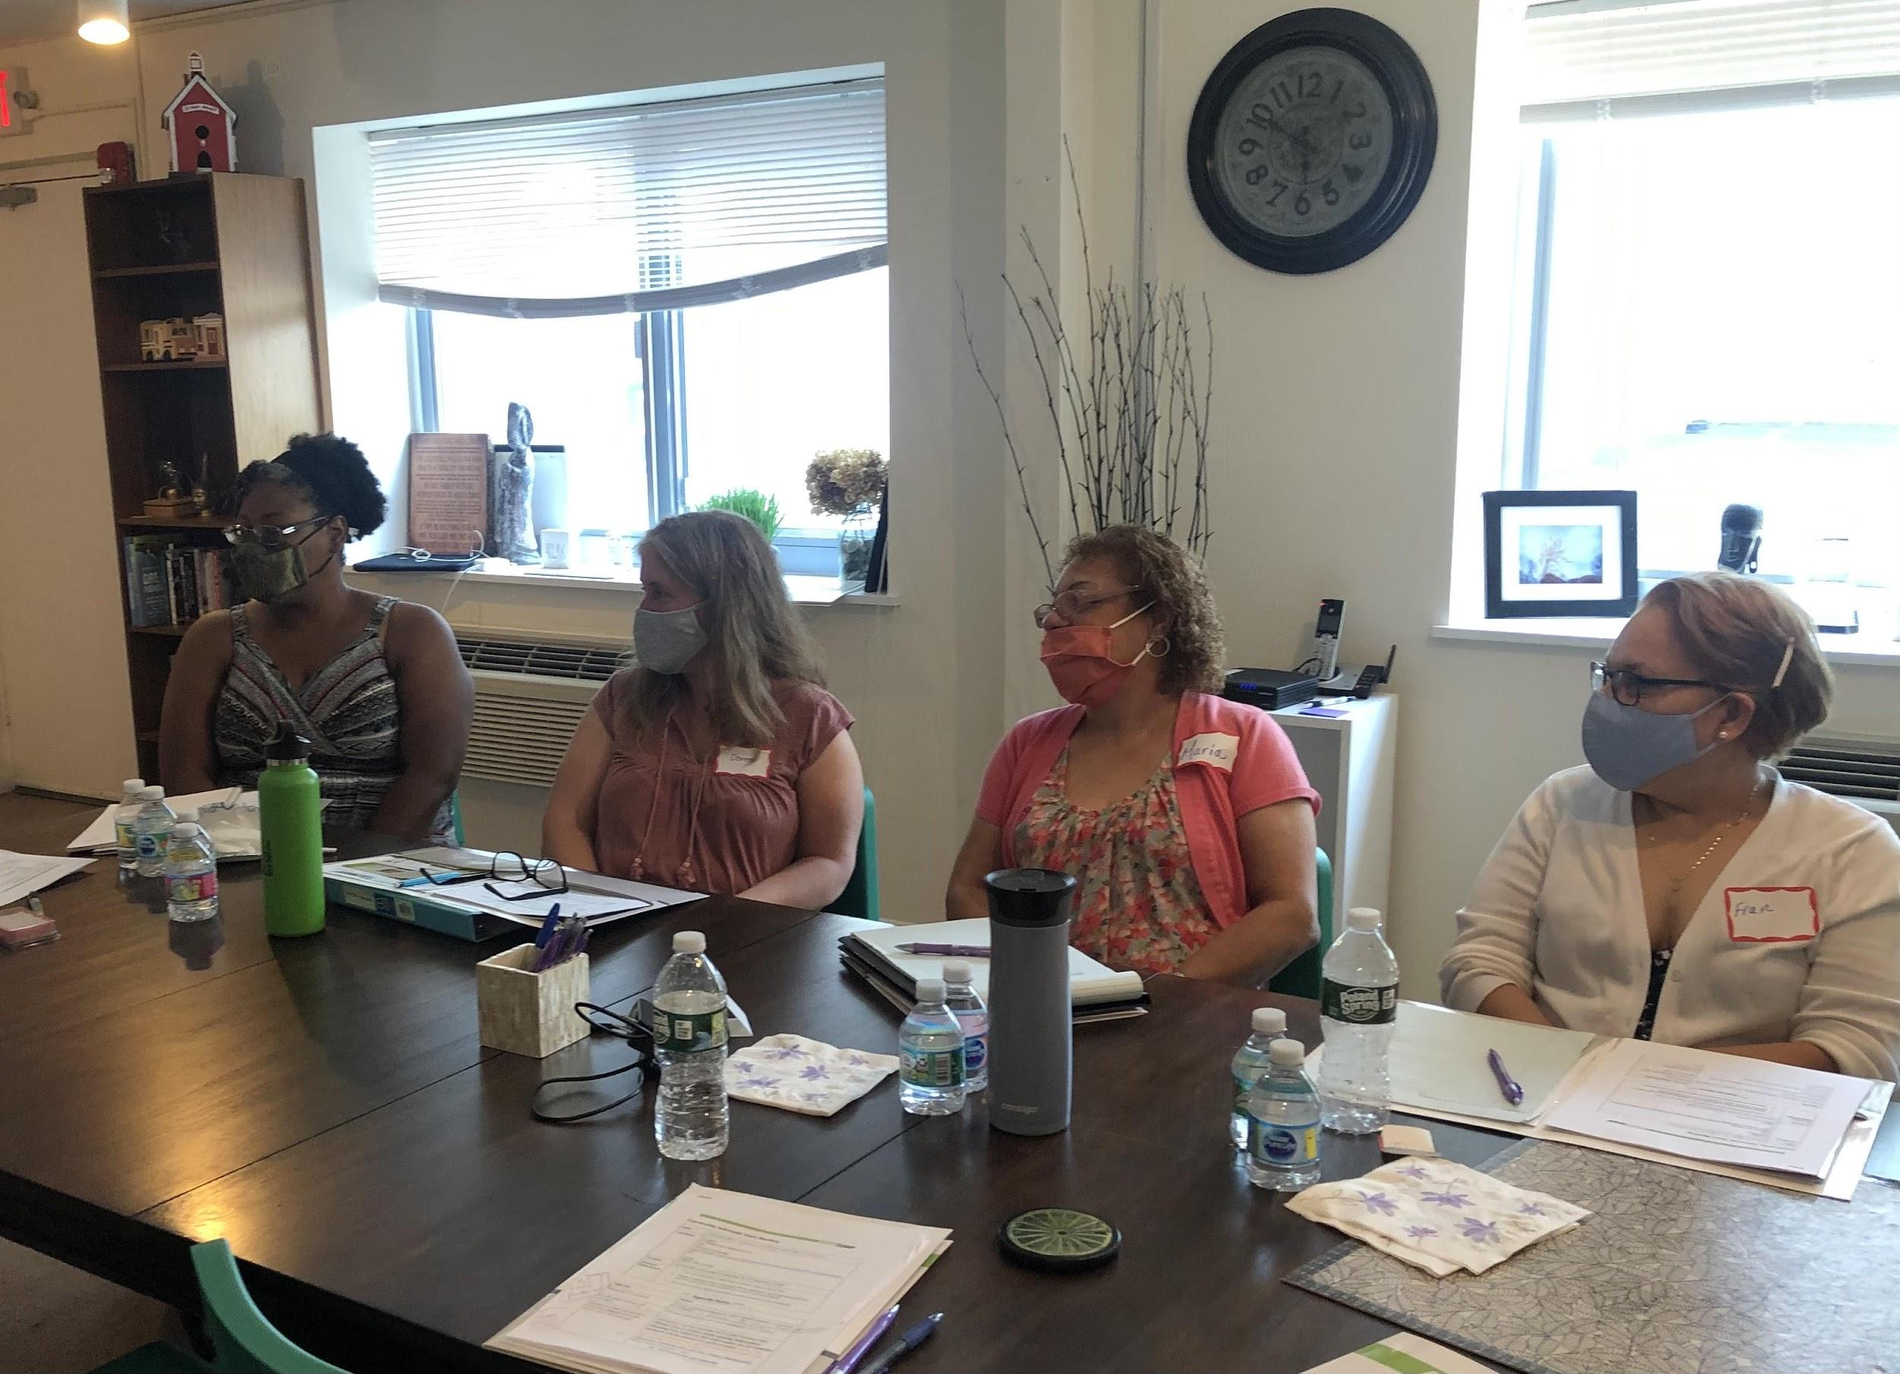
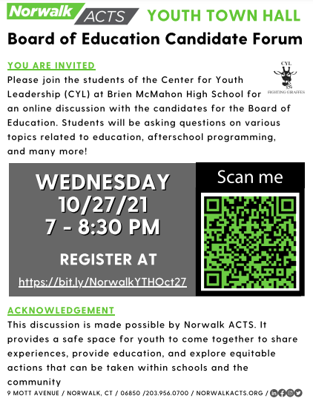
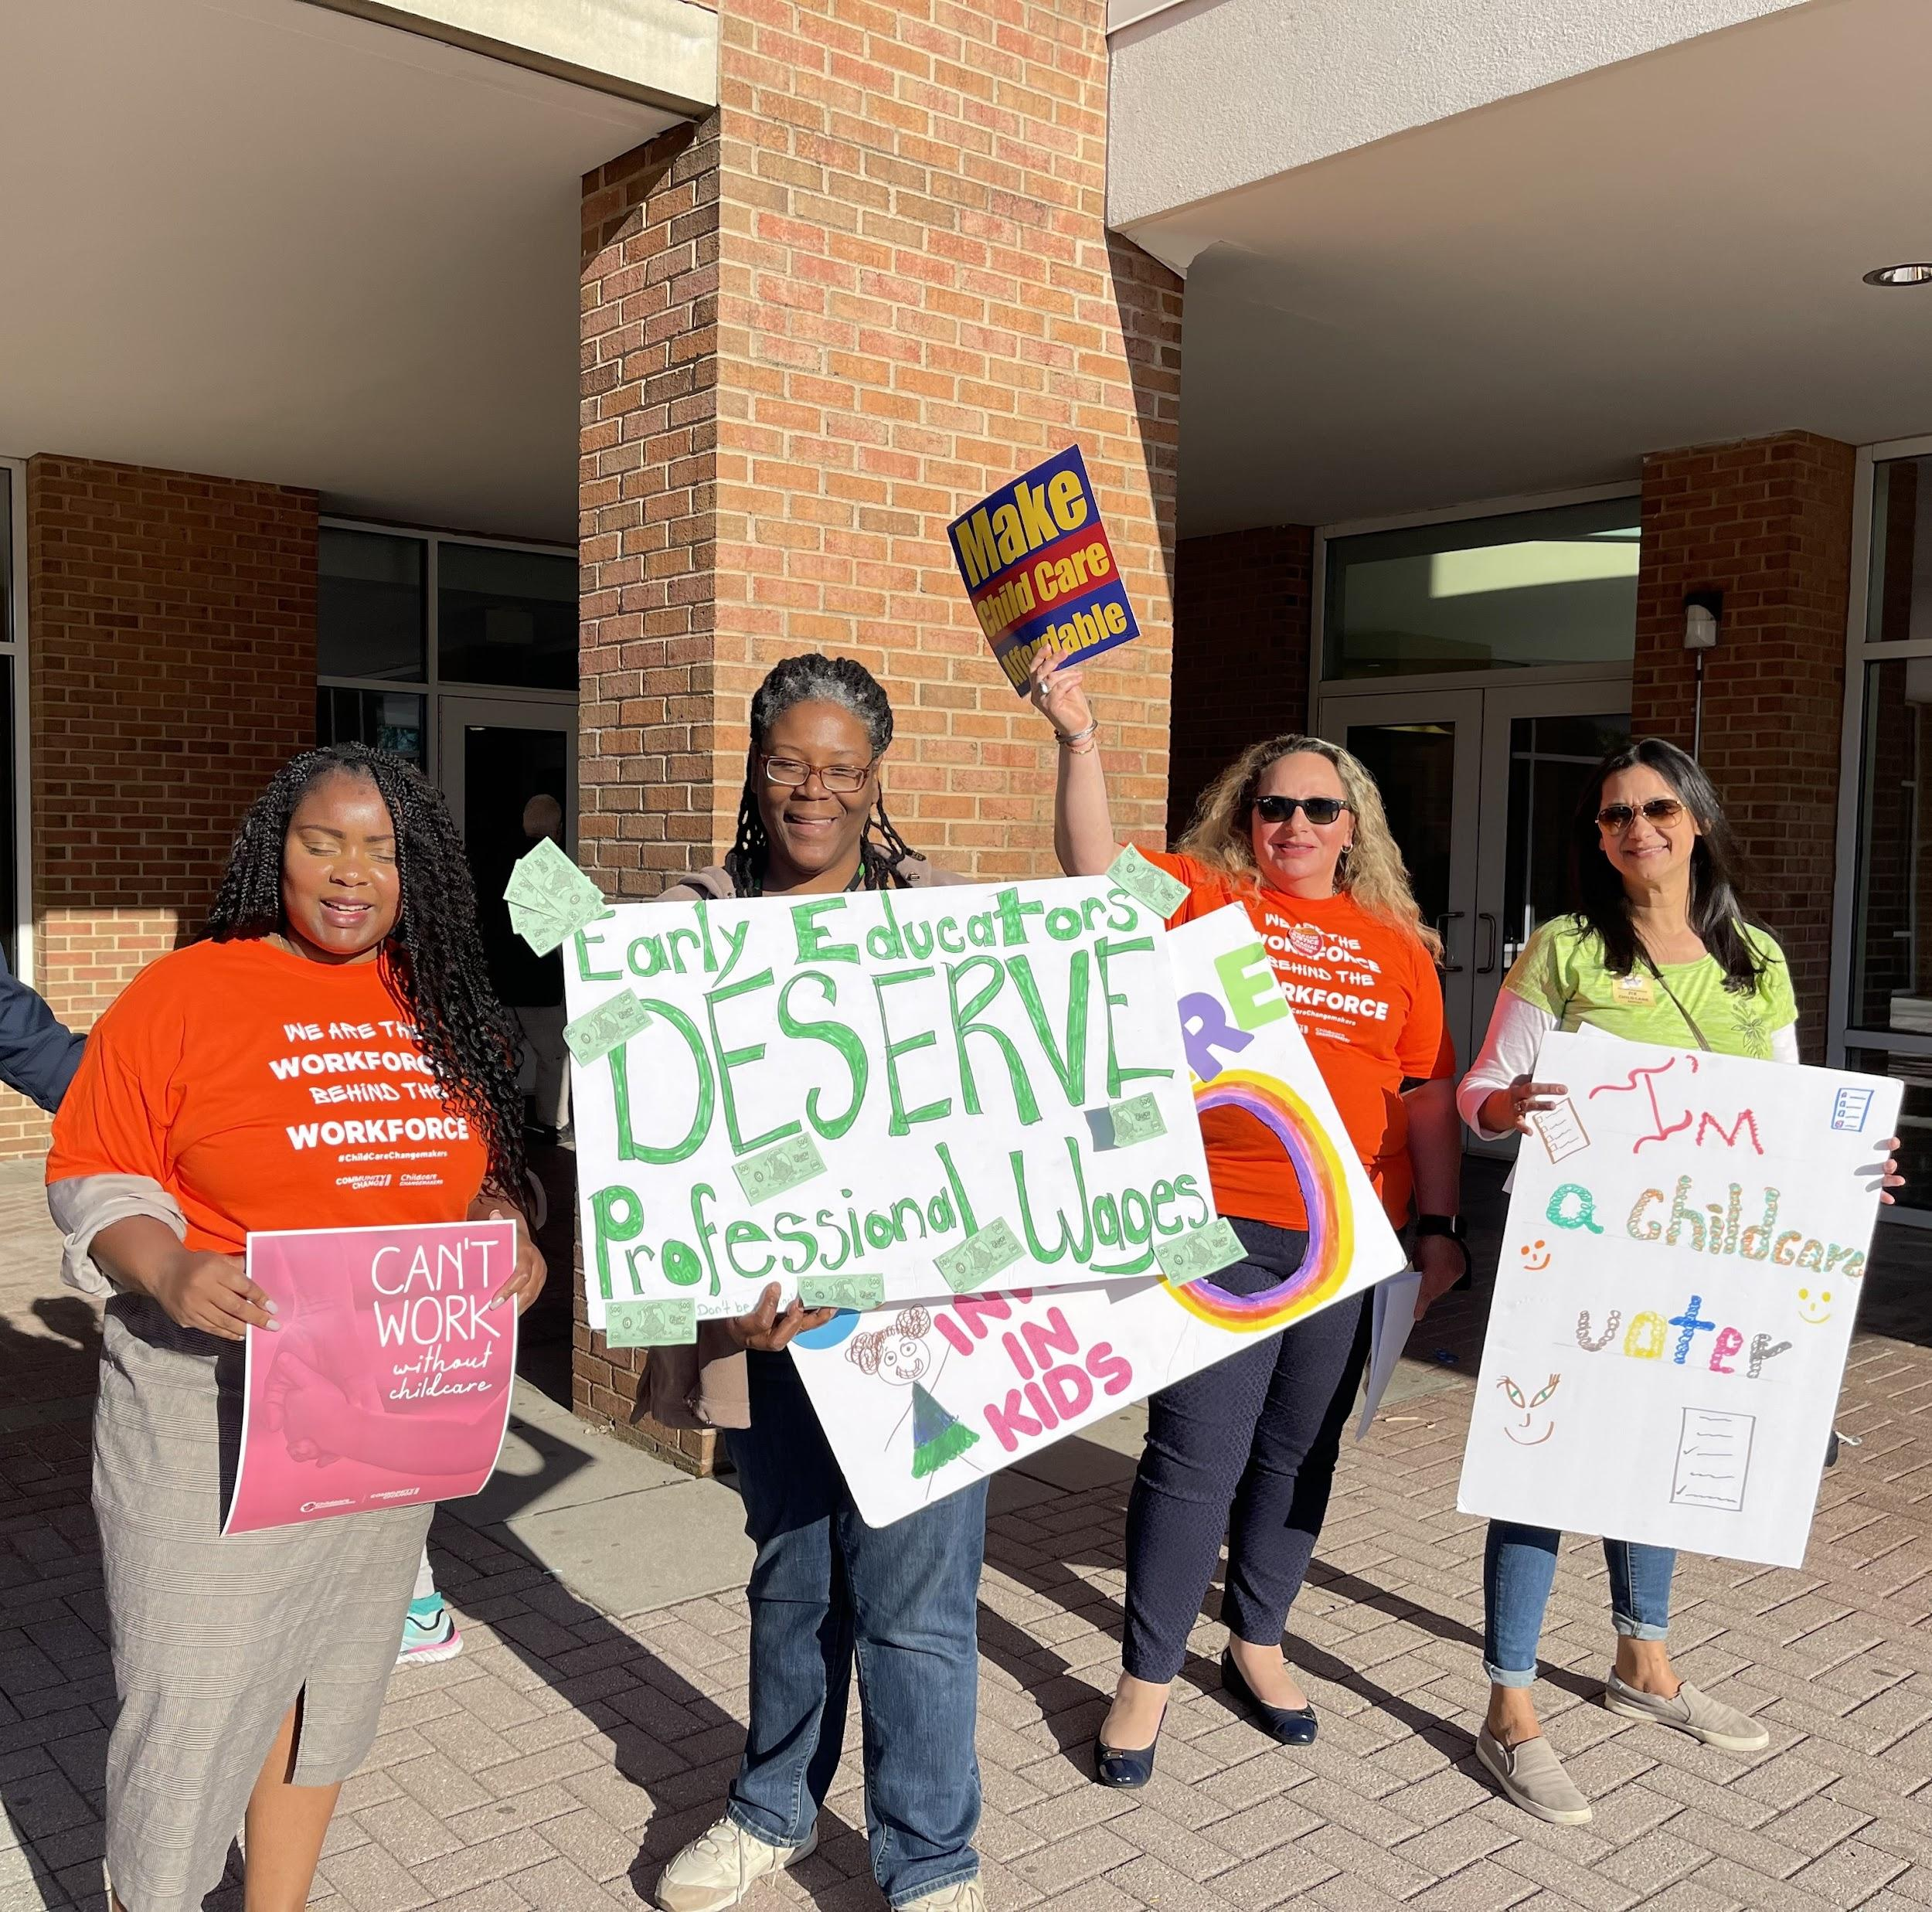
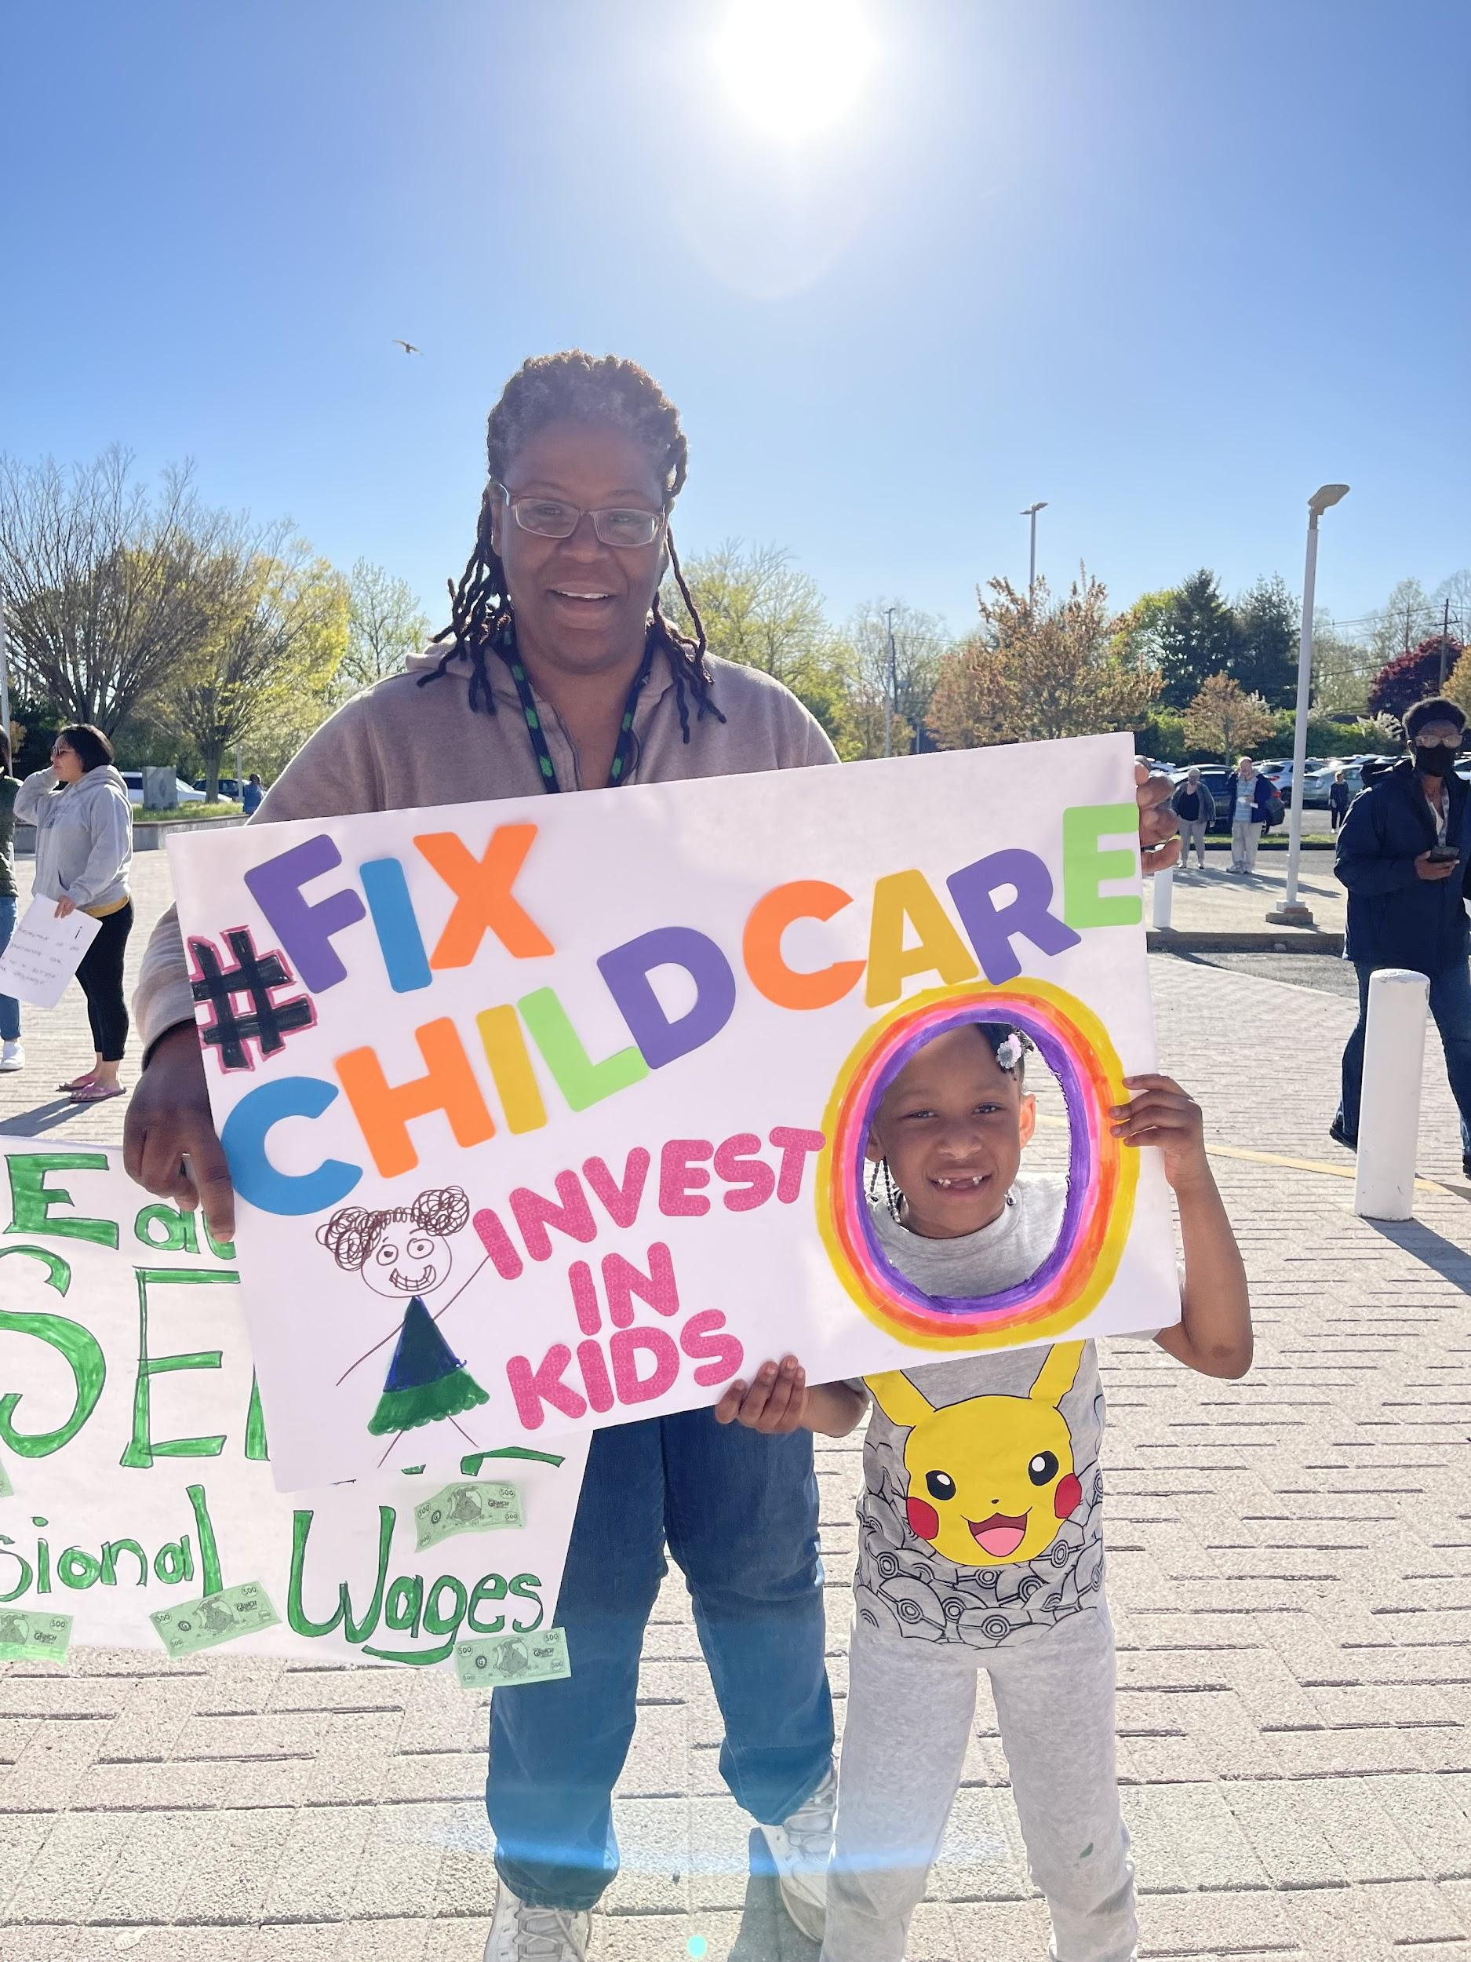
Principles of Community Engagement in the Norwalk ACTS ecosystem - 2021-22
Notes:
Connect each bullet point to why each things matter
Data - Our best efforts to create systemic change “even when guided by data and evidence, will not succeed without community members’ experience, knowledge, relationships, skills, and participation.” These assets are often overlooked and untapped.
SJE - Leadership positions need to be more representative of our community members most impacted by systems change -- black, brown, hispanic, Latin(x), Asian and other races/ethnicities.
Policy/Advocacy - “A shift in power where community members (youth, families, residents) own and help produce the result leads to a greater impact.”
CE - In order to create real social economic change in Norwalk, we must co-develop solutions ‘with’ community and not ‘for’ community.
Resource: https://www.collectiv

Slide 14
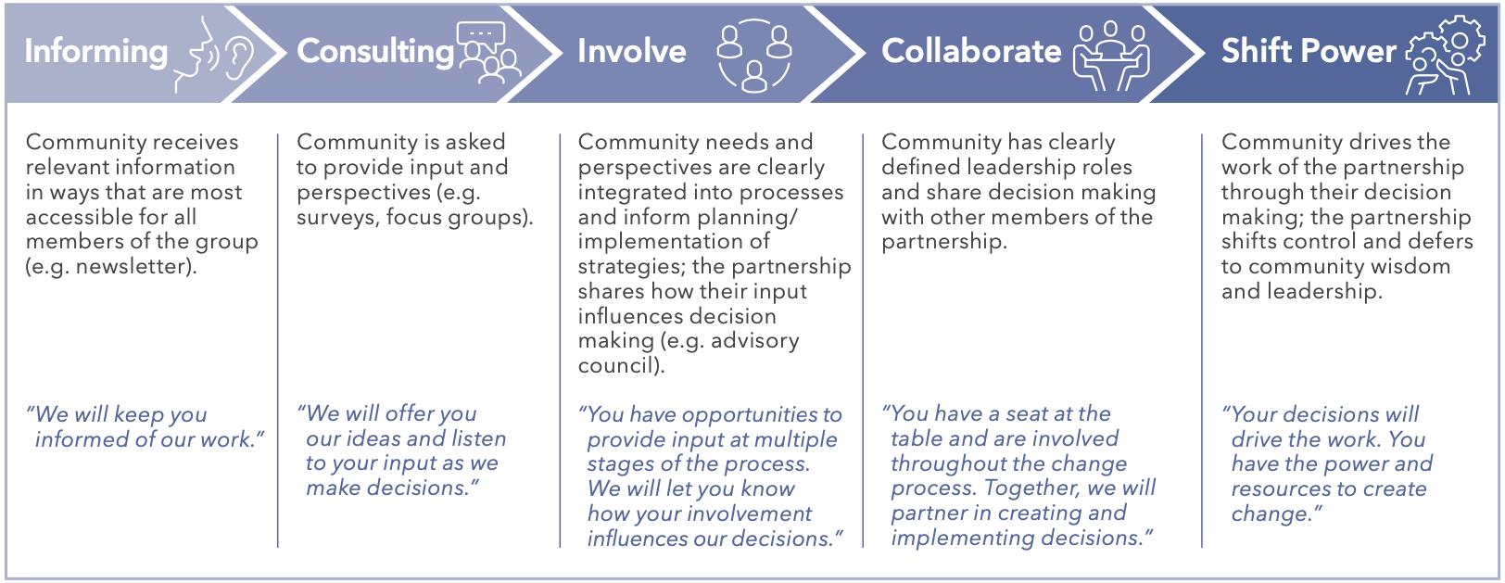
Levels of Community Engagement
Notes:
have an example of activities aligned with spectrum- youth.
https://docs.google.com/document/d/1WCXZ_W36AsVUzhKwBiY8y_b81qk654-9z1RPUI3TR2M/edit?usp=sharing

Slide 15
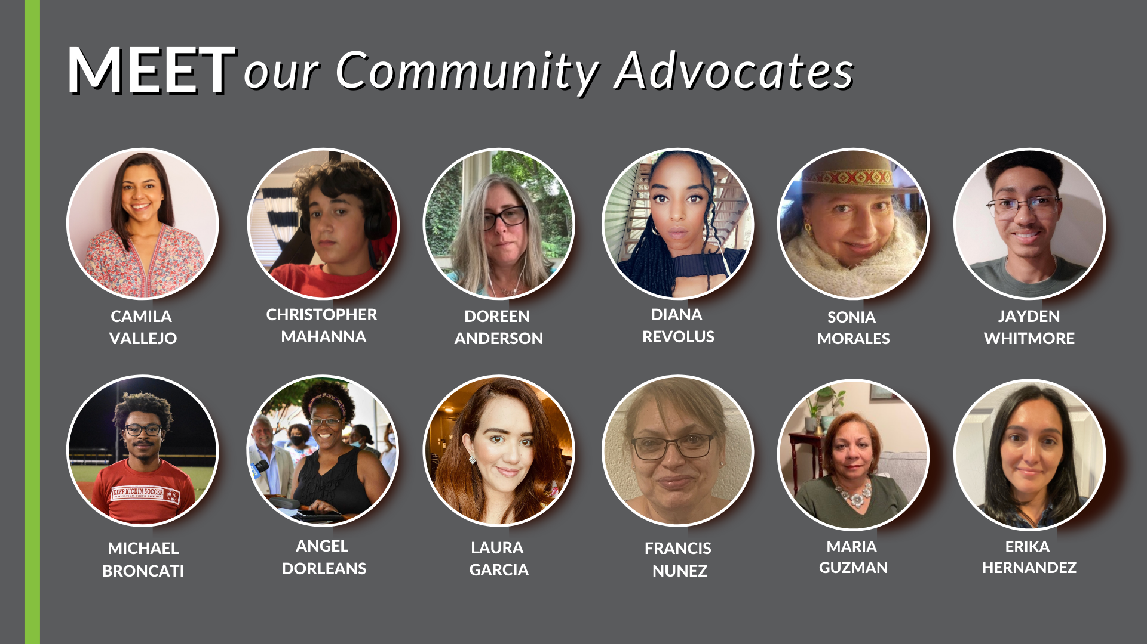
Community Advocate Experiences

Slide 16
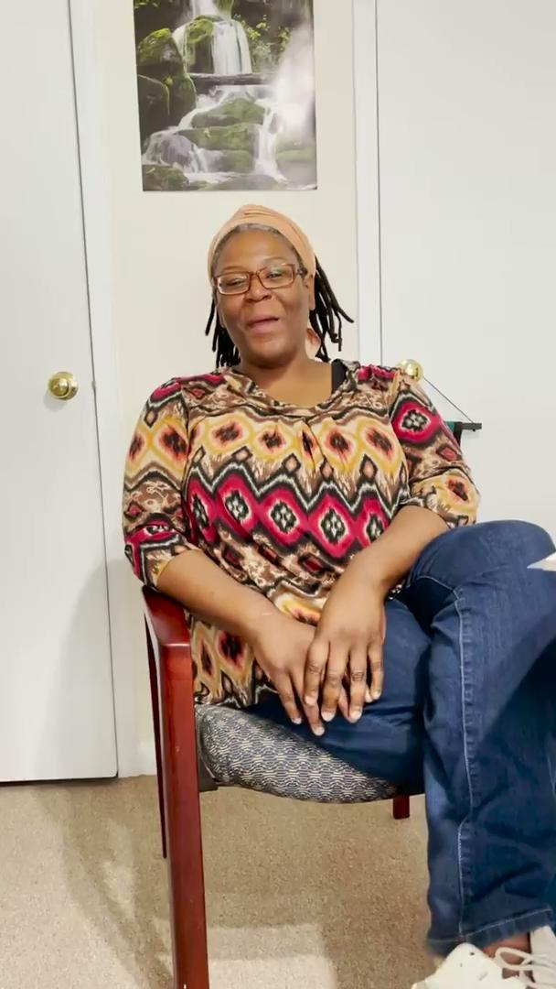
Angel Dorleans

Slide 17
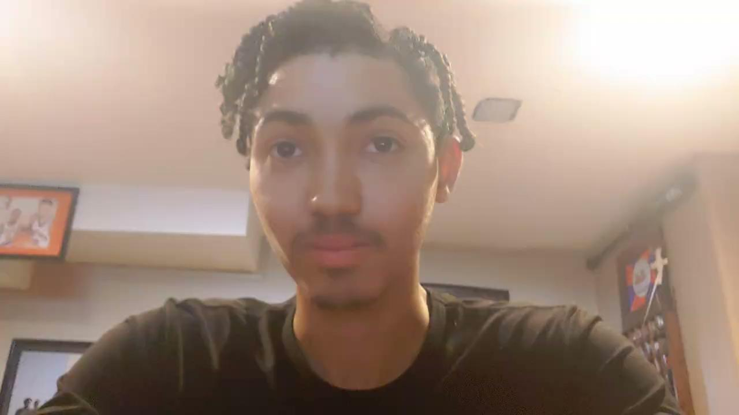
Jayden Whitmore

Slide 18
Francis Nunez

Slide 19
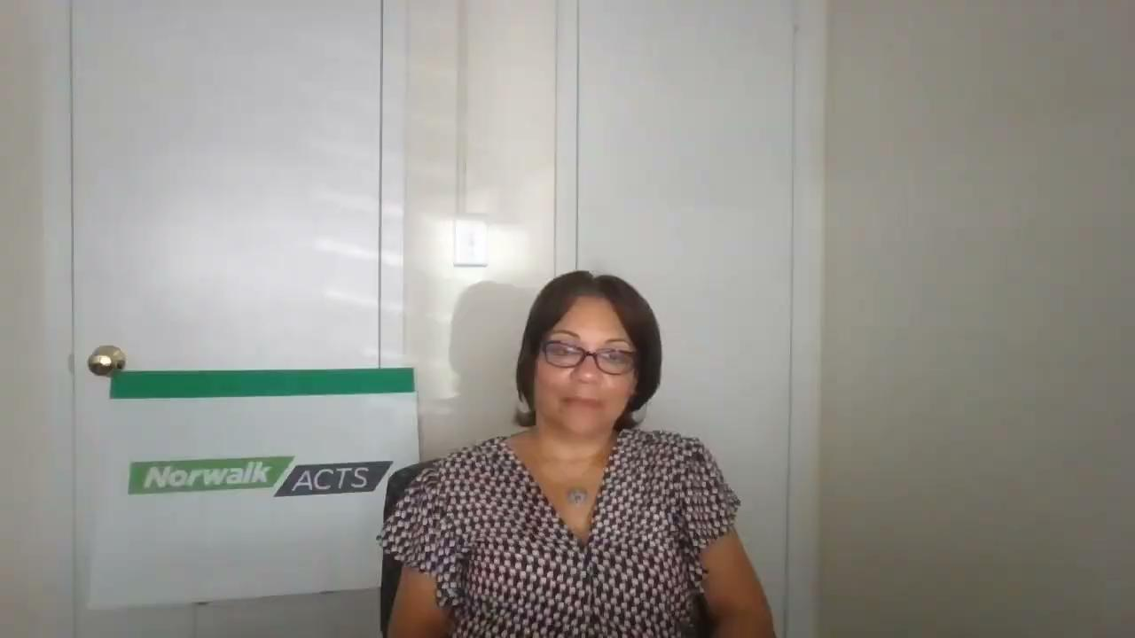
Maria Guzman

Slide 20
Sonia Morales

Slide 21
Laura Garcia

Slide 22
Chris Mahanna

Slide 23
Early Thinking for Community Engagement ‘22-23 Priorities
Intentional Alignment of Initiative/Workgroup Goals with Community Engagement Actions
Continue Early Childhood Community Advocate program with Norwalk Early Childhood Education Providers and potentially expand work by introducing Sparkler and engaging parents with children from Birth to 3 years of age
Shift part of Community Advocate program by hiring targeted Community Engagement Specialists
Youth Summit in Norwalk
Notes:
To EDIT

Slide 24
Community Engagement Supports
THANK YOU to the Community Engagement Advisory Group and the many community members who guided the development of the program, provided referrals to engage adults and youth and assisted with community resource training.
CE Advisory Group
Rev. Elizabeth Abel
Diana Carpio
Barbara Meyer-Mitchell
Mary Oster
Sarah Rendon Garcia
Iliana Zuniga

Slide 25
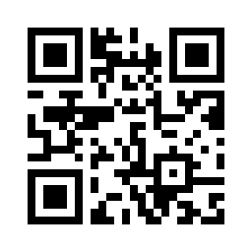
5 Minute Break - Board Vote QR Code
https://bit.ly/NABoardVote
*Only Norwalk ACTS members who signed the 2020 MOA are eligible to vote.

Slide 26
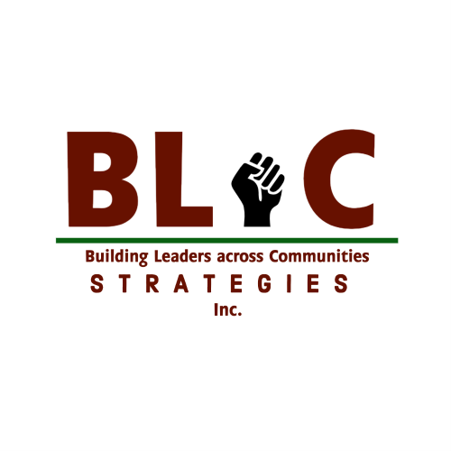
CONSISTENT & PERSISTENT
MORE EFFECTIVE STRATEGIES FOR
AUTHENTIC COMMUNITY ENGAGEMENT

Slide 27
KIRK A. WESLEY
Husband, Father, and Entrepreneur
Organizing Consultant, Congregations Organized for a New CT (CONECT)
Political Strategist, The Field LLC
Co-Founder, Building Leaders across Communities (BLaC) Strategies
The White Ally Coach™

Slide 28
DEFINING AUTHENTIC COMMUNITY ENGAGEMENT
CONSISTENT and PERSISTENT engagement with an entire community for the purpose of establishing a foundation of PARTNERSHIP, TRUST and EMPOWERMENT.

Slide 29
DEFINING AUTHENTIC COMMUNITY ENGAGEMENT
PARTNERSHIP:
Working in tandem with community members and stakeholders to accomplish joint objectives of community revitalization
TRUST:
Building genuine relationships through shared goals and common interests.
EMPOWERMENT:
Creating opportunities for community members to obtain ownership, power and authority over their own collective destiny by working with neighbors as decision makers to improve their community

Slide 30
UNDERSTANDING AUTHENTIC COMMUNITY ENGAGEMENT
In this work, LIVED EXPERIENCE MUST DRIVE DECISION MAKING.
Quantitative data alone can never capture the humanity behind the number
We must always find ways to tie the Qualitative data, acquired through genuine relationship building across diverse communities, to shape the narrative around what the metrics show.
LIVED EXPERIENCE MUST DRIVE DECISION MAKING

Slide 31
UNDERSTANDING AUTHENTIC COMMUNITY ENGAGEMENT
it’s not just about LISTENING to people, it’s about HEARING people and VALUING what you hear. Hearing people out and valuing what they have to say is how you cultivate “COMMUNITY BUY IN”
“COMMUNITY BUY IN” is when the community endorses or supports an initiative and views themselves as a STAKEHOLDER in the process.
THE LIVED EXPERIENCE OF THE COMMUNITY MUST DRIVE DECISION MAKING

Slide 32
UNDERSTANDING AUTHENTIC COMMUNITY ENGAGEMENT
Other forms of community engagement that are not AUTHENTIC:
Symbolic Engagement
Engagement which is designed to serve a purpose other than building relations, establishing trust, and empowering residents
Perfunctory Engagement
A modest form of engagement which engages a small fragment of the community residents to serve as representatives of the entire community

Slide 33
AUTHENTIC COMMUNITY ENGAGEMENT PRODUCES:
Strong Social Cohesion
Collective Efficacy
Builds Community Capacity
Strengthening of Institutional Legitimacy & Trust
AUTHENTIC COMMUNITY ENGAGEMENT IS MUTUALLY BENEFICIAL

Slide 34
DEFINING AUTHENTIC COMMUNITY ENGAGEMENT (AGAIN)
CONSISTENT and PERSISTENT engagement with an entire community for the purpose of establishing a foundation of PARTNERSHIP, TRUST and EMPOWERMENT.

Slide 35
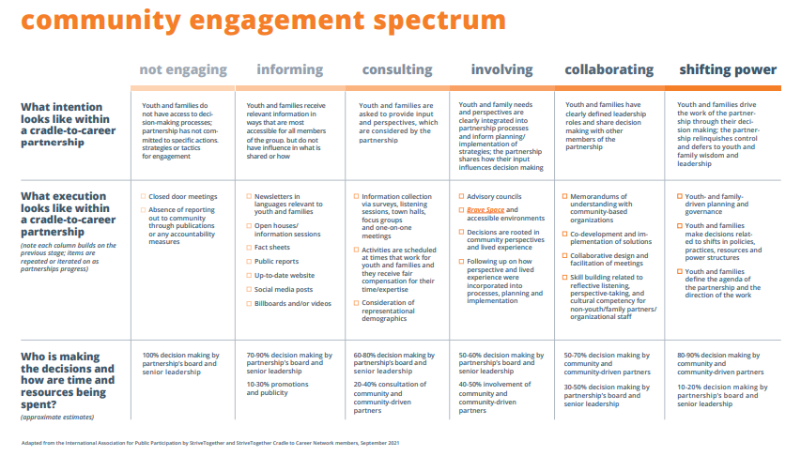
COMMUNITY ENGAGEMENT SPECTRUM

Slide 36
THANK YOU!

Slide 37
Our 2nd Annual Partnership Survey
5-10 minutes
All answers will be anonymous.
All multiple choice questions with three optional open-ended questions
The results of the survey will be developed into a partnership progress report that we will present to our membership on an annual basis to hold ourselves accountable.

Slide 38
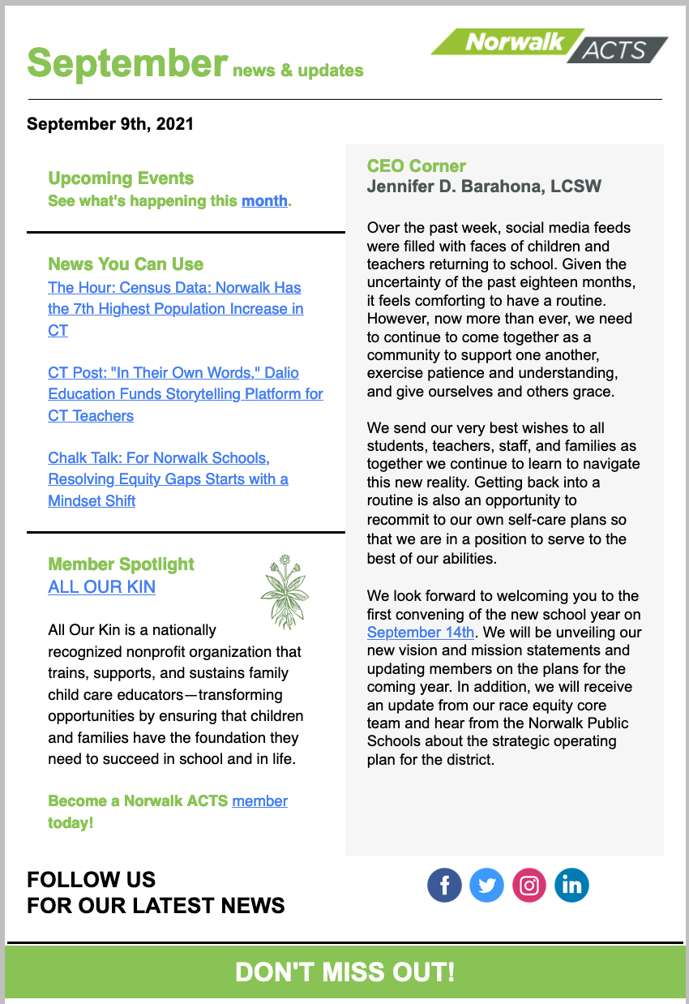
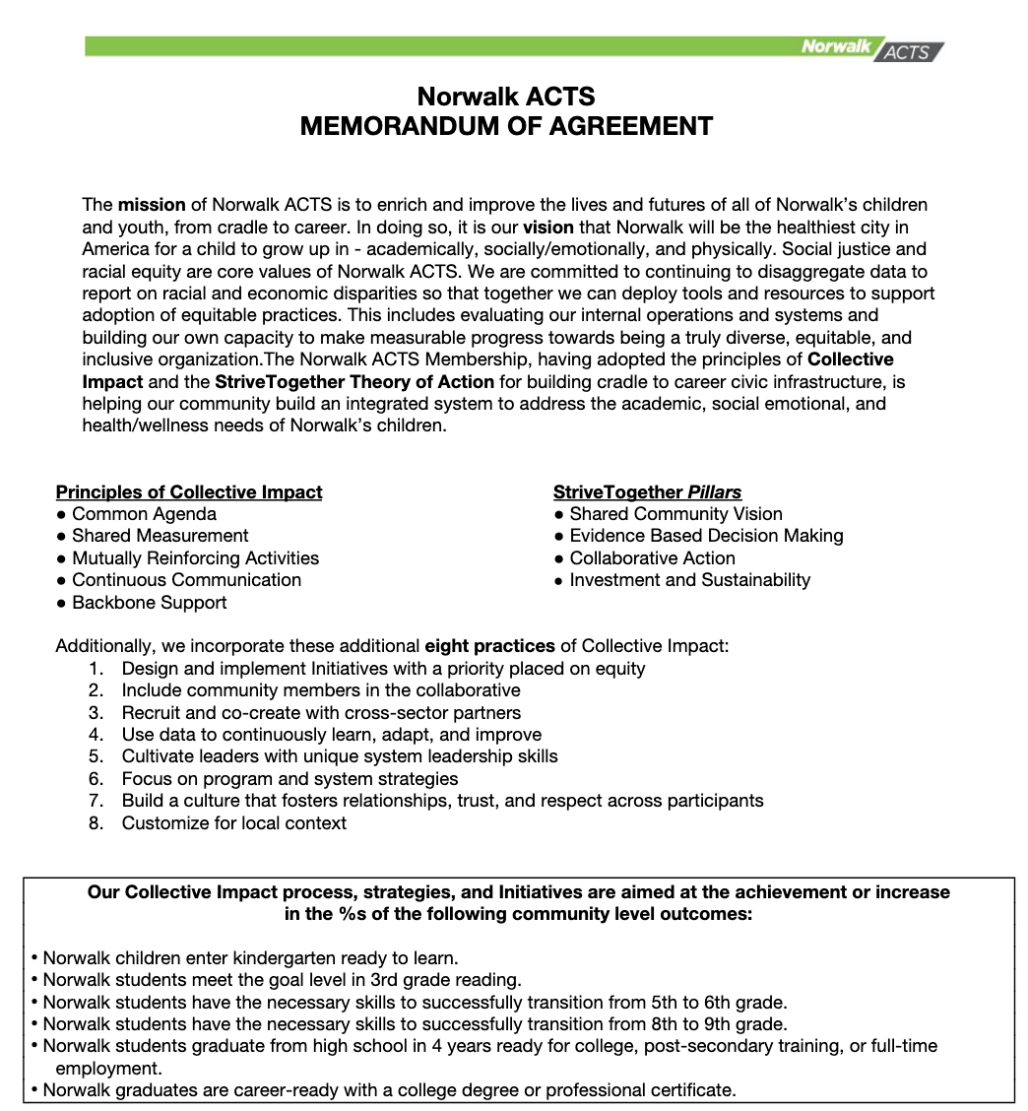
Closing
Sign up on our website for our newsletter!
Are you a member? Please sign our digital Memorandum of Agreement (MOA).
Notes:
https://forms.gle/a5rpgFJu6S9QFjex7

